Slide 1
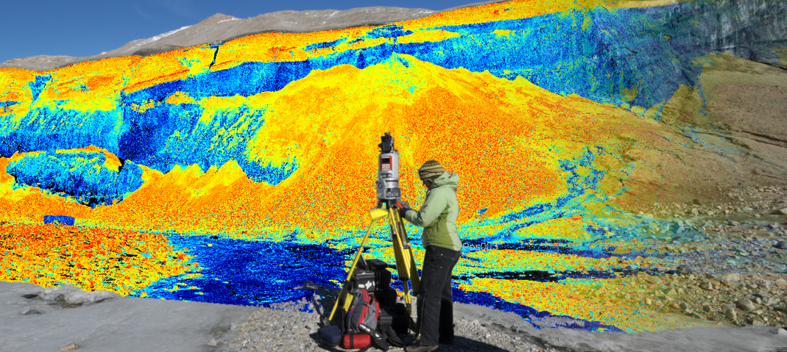


2015 AGU Student & Early Career Scientist Conference
High Resolution Topography Resources
Christopher Crosby
UNAVCO / OpenTopography
Boulder, CO

Slide 2
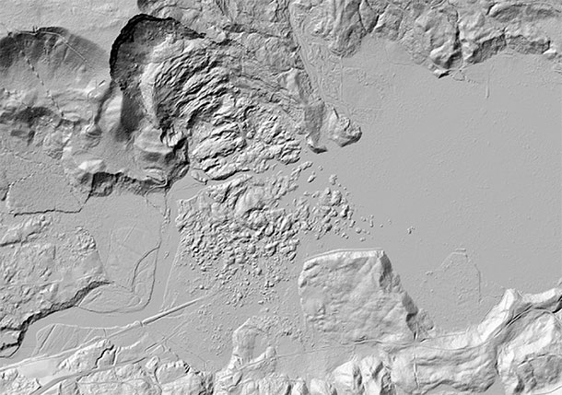
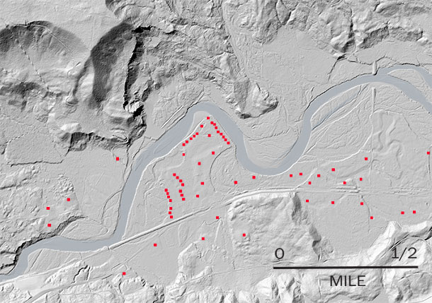


Topography = fundamental observable
How do geopatterns on the Earth’s surface arise and what do they tell us about processes?
How do landscapes influence and record climate and tectonics?
What are the transport laws that govern the evolution of the Earth’s surface?
How best can we retrieve the record of paleoearthquakes from the landscape?
2014 Oso, WA landslide credit: Washington Post

Slide 3
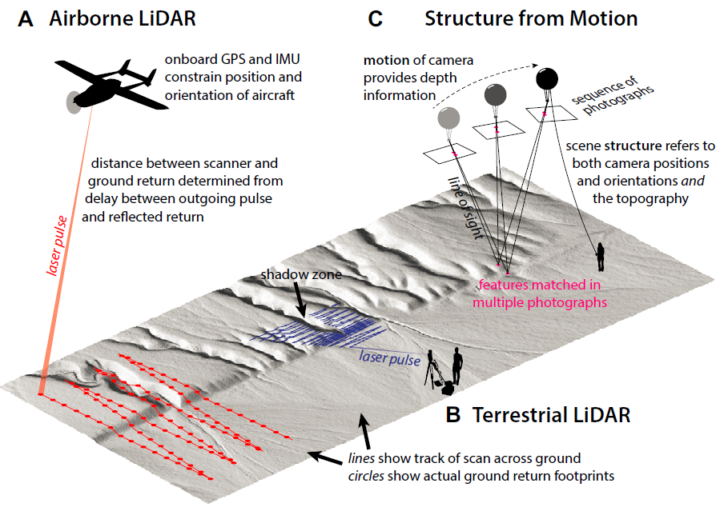
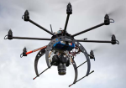
Multi-Temporal, High-Resolution Topography
Optimizing coverage in time, space, and resolution for the question
Sub-cm to meter scale; days to decades repeat times
Johnson, K. et al, Geosphere; doi:10.1130/GES01017.1, 2014.

Slide 4
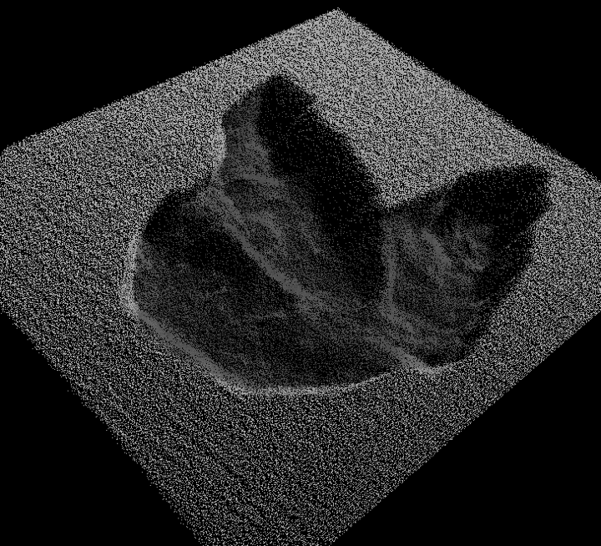
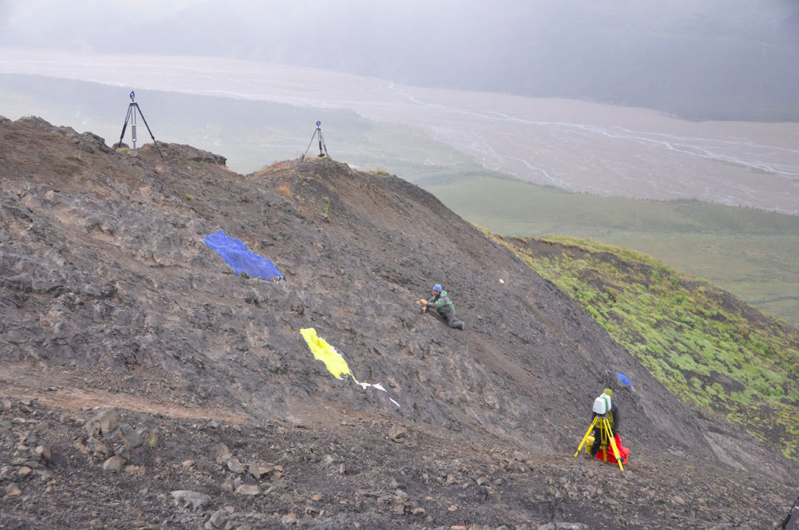
Hadrosaur Trackways on Denali
Fiorillo, et al., 2014, Geology, DOI: 10.1130/G35740.1

Slide 5
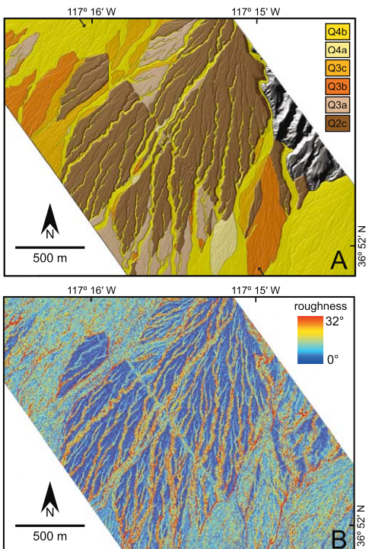
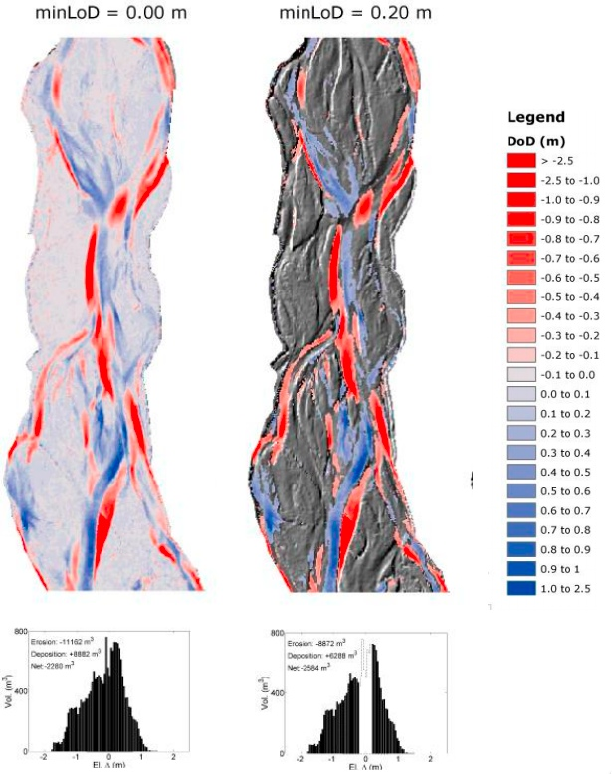
Geomorphic Change Detection
Alluvial fan surface characterization to constrain fault slip rate
Wheaton et al.
Frankel and Dolan, 2007

Slide 6
Whipple et al., 2012
Drainage networks and stream profile analysis

Slide 7


Facilities
NSF EAR’s investment in high resolution topography
 | Terrestrial laser scanning (TLS) instrumentation and expertise PI & graduate student support Data archiving Education and training
 | Airborne lidar data collection PI & graduate student support Graduate student seed grants (funding) Education
 | Online data discovery and access Custom data products and processing Cyberinfrastructure R&D Education and training

Slide 8
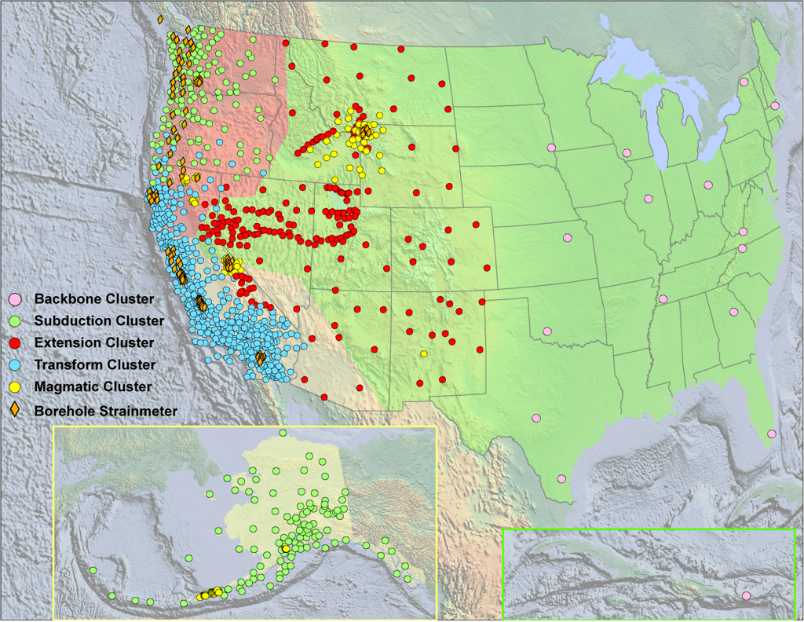
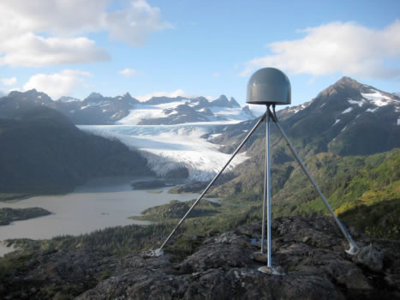

What is UNAVCO?
UNAVCO is a non-profit, membership governed consortium of universities that facilitates geoscience research and education using geodesy.
UNAVCO supports GPS, InSAR and lidar data acquisition, data archiving, equipment, development & testing, training.
UNAVCO operates and maintains the Plate Boundary Observatory network of instruments.
UNAVCO Education & Community Engagement works to promote a broader understanding of Earth science.

Slide 9

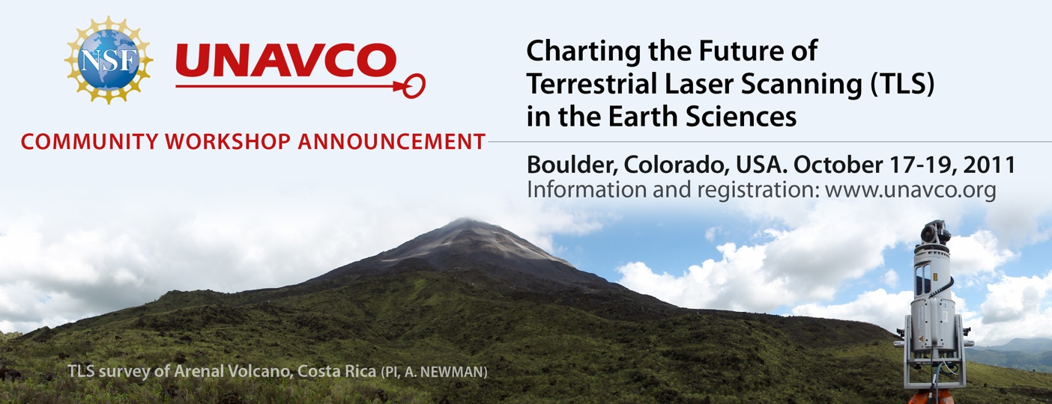
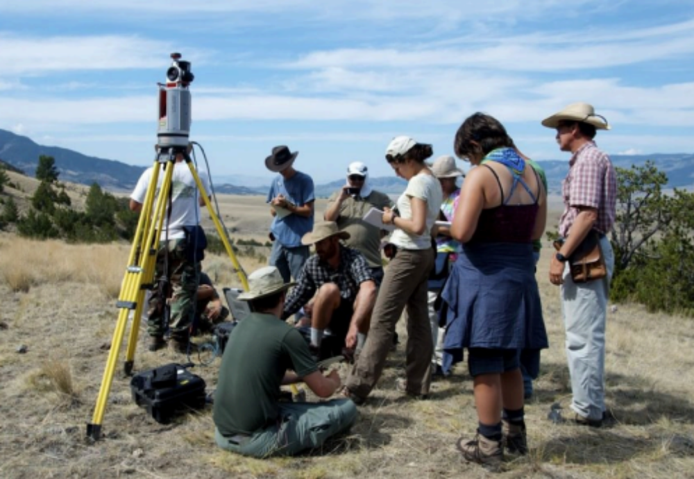
UNAVCO TLS Support Resources
Technical Support
Instrumentation (7 scanners)
Field engineering
Data processing
Data archiving
Software licenses
Community Building
Education and Community Engagement
Training short courses
TLS in field education
Internships

Slide 10
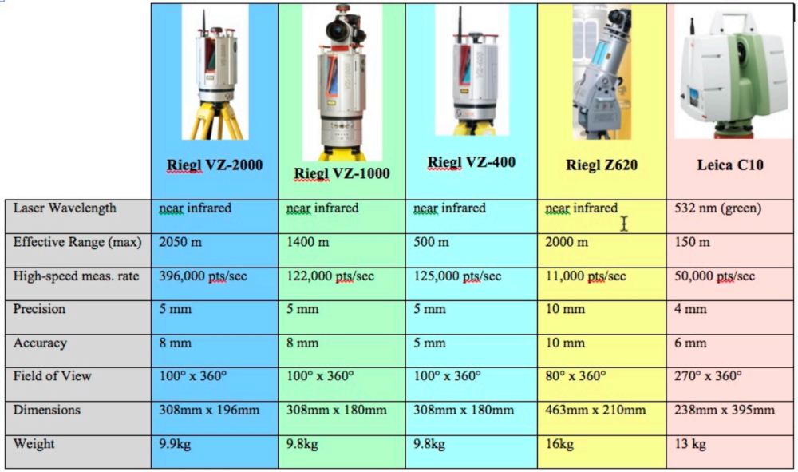
UNAVCO TLS Instrument Pool
License server w/ access to RiScan Pro, Cyclone, Polyworks, ArcGIS, Quick Terrain Modeler, MatLab,
Campaign and RTK GPS, tripods, various power supply options
Instrument validation range

Slide 11
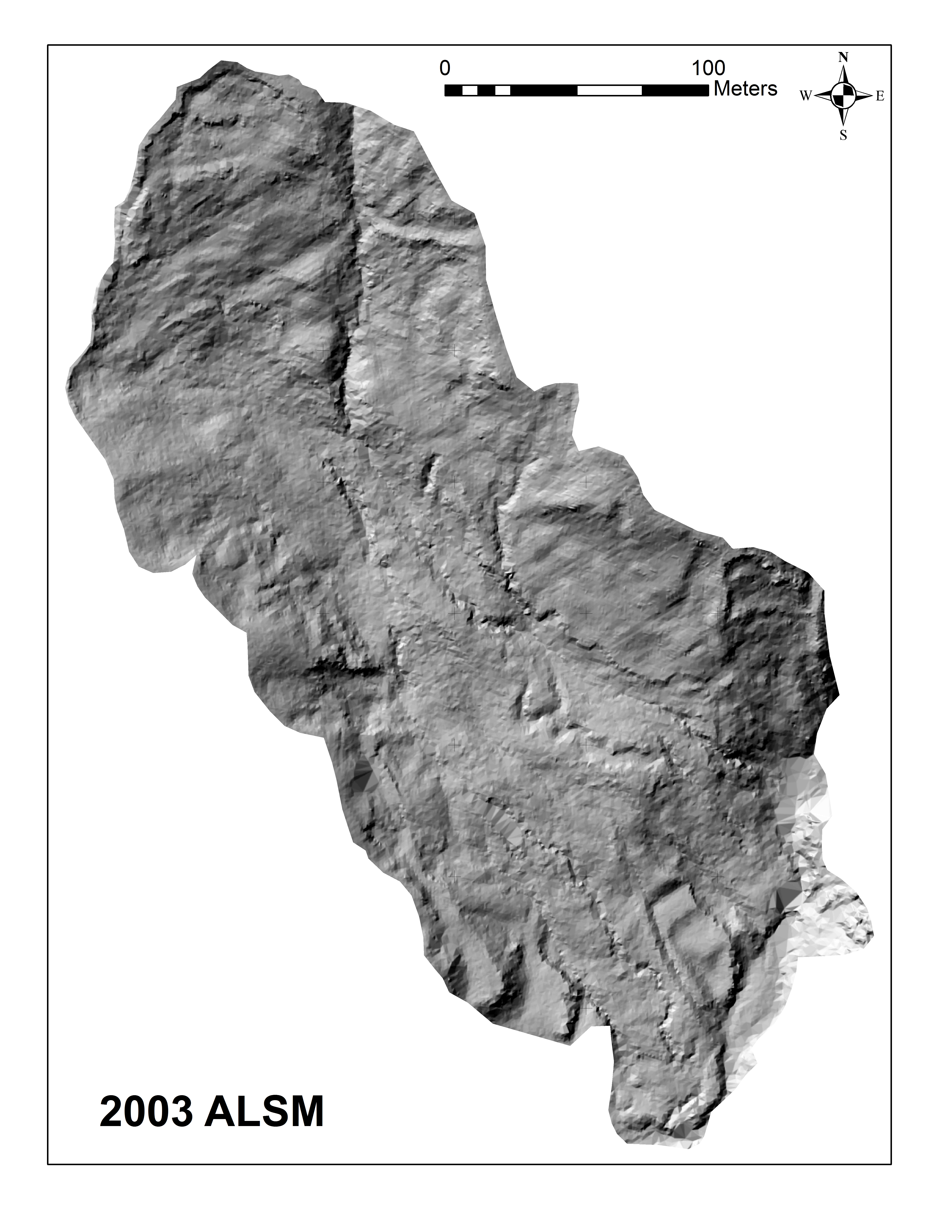
UNAVCO TLS PI Support – Costs & Prioritization
TLS Support Costs:
For NSF-supported projects, PI pays field engineer travel and equipment shipping.
For non-NSF supported work,
full cost recovery required.
Project Prioritization:
NSF-EAR and NSF-OPP = highest priority.
NSF-other and non-NSF = projects supported as resources allow.
Mill Gulch earth flow, Sonoma, CA
Steve DeLong, USGS

Slide 12
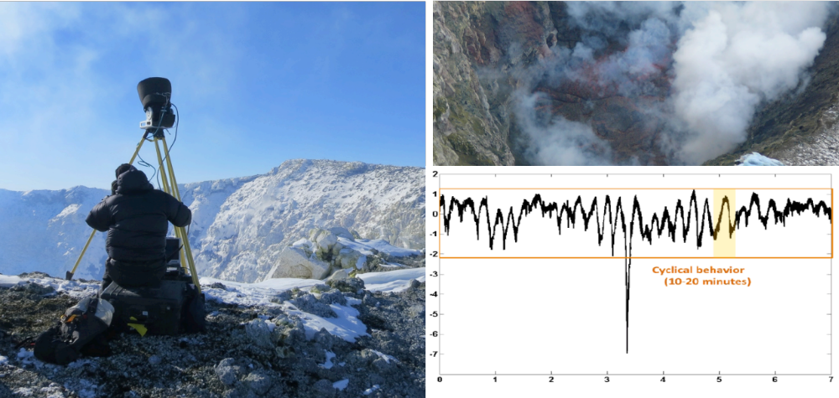
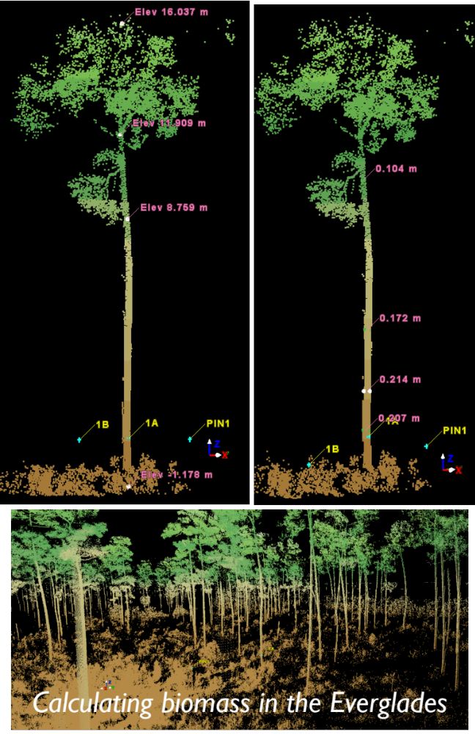
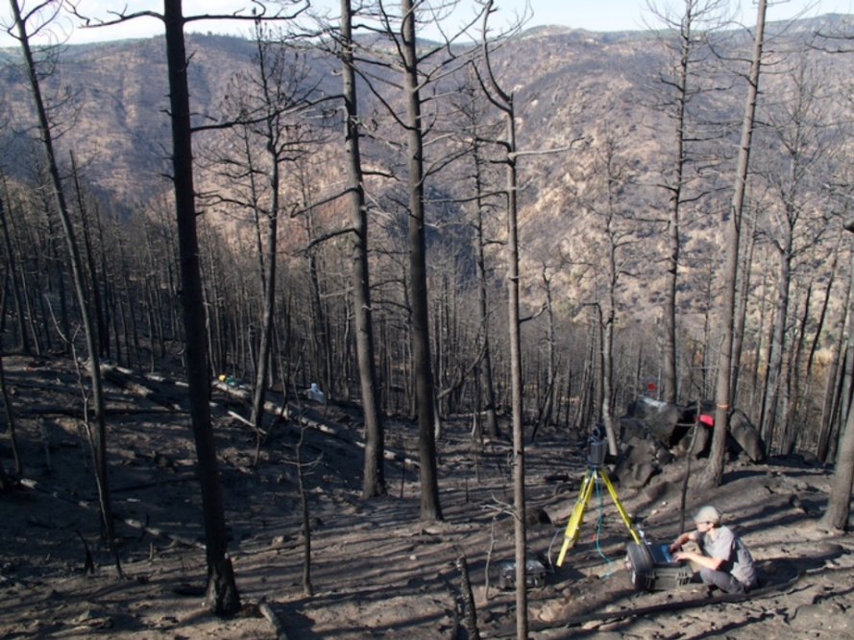
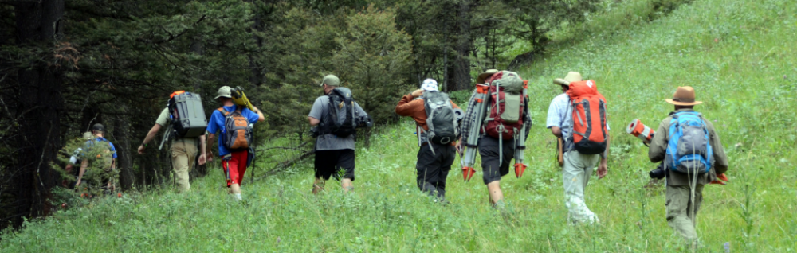
Mount Erebus, Antarctica
Quantifying landscape response to wildfire
Biomass calculation
Indiana University Geologic Field Camp

Slide 13
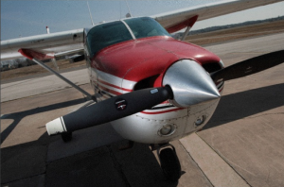
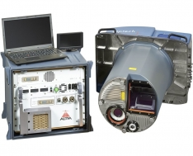
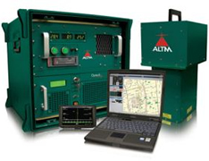
Based at University of Houston & University of CA, Berkeley
Funded by NSF EAR-IF program. Initiated in 2003, funded through 2018.
Cessna 337 Skymaster:
  Titan three wavelength (532, 1064, and 1550 nm), 300 kHz (per wavelength) lidar
  AQUARIUS Green bathymetric/topographic lidar
Collect data for NSF-funded researchers. Cost integrated into proposal budgets.

Slide 14
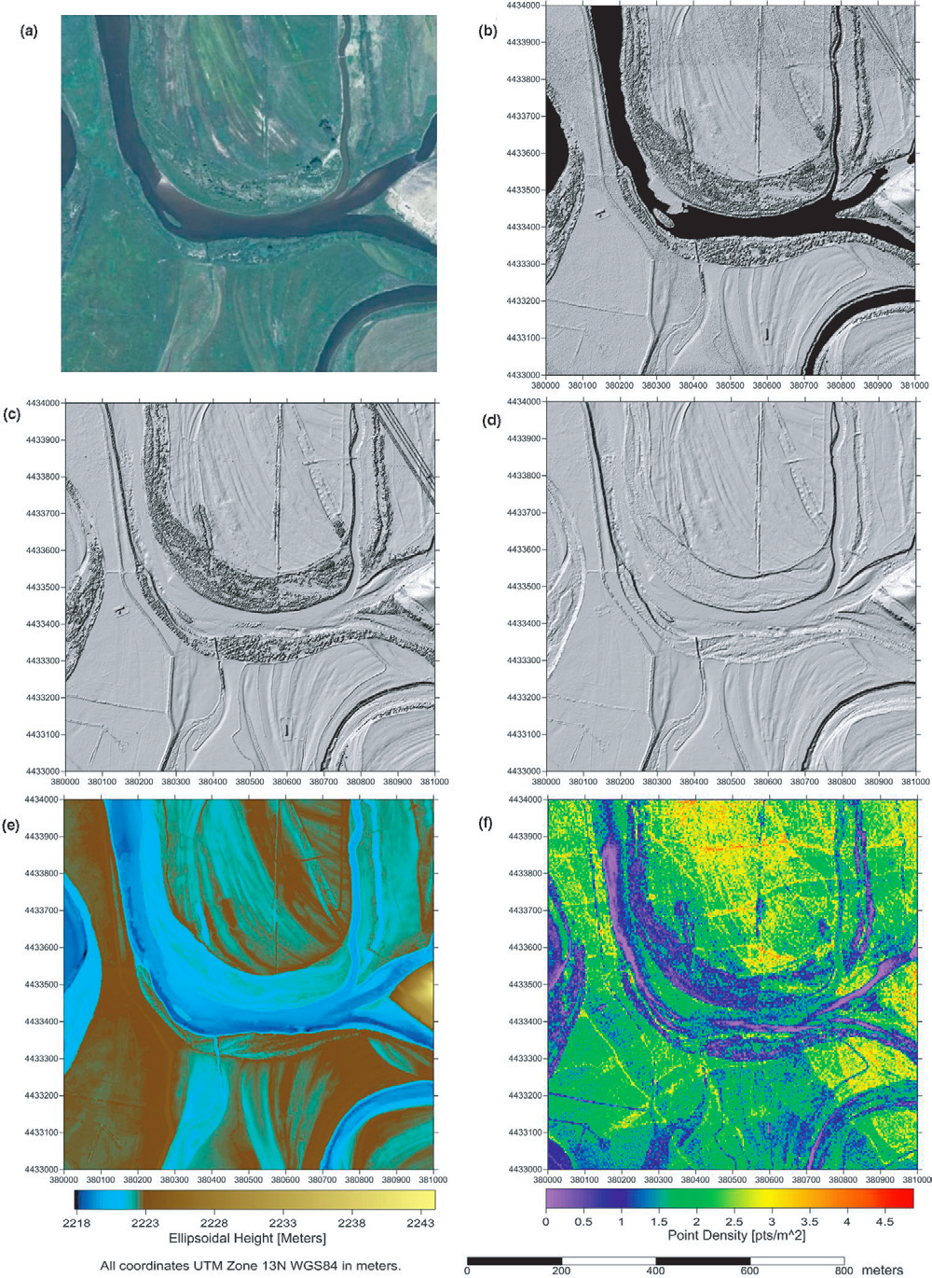
Research-oriented data
Typically 8+ pts/m², 0.5 - 1 meter resolution DEMs.
Data openly available after 2 yrs via OpenTopography.
152 datasets collected through 2015
Numerous publications and educational impacts from these data
Seed grant program provides 40km² of data for graduate students through annual proposal process.

Slide 15
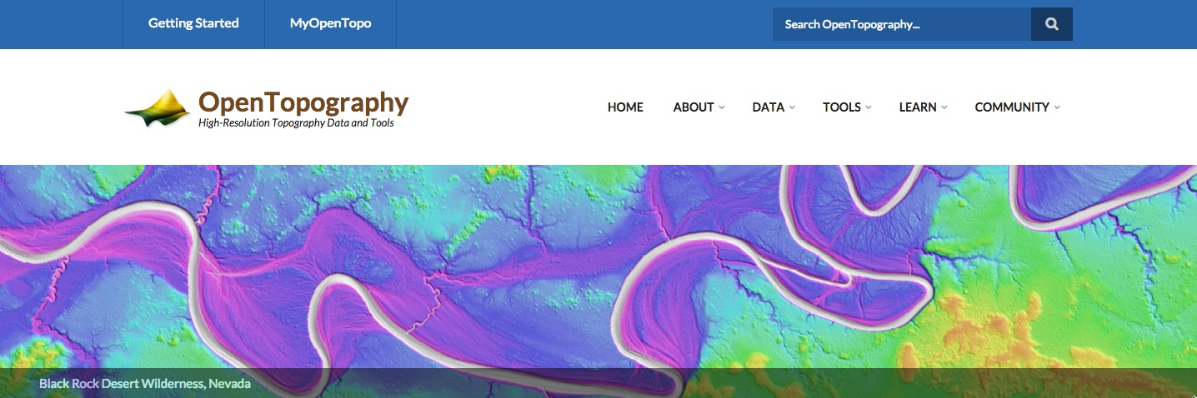
Democratize online access to Earth science-oriented high-resolution topography
Lidar (ALS & TLS), Structure from Motion, satellite (e.g., SRTM)

Slide 16
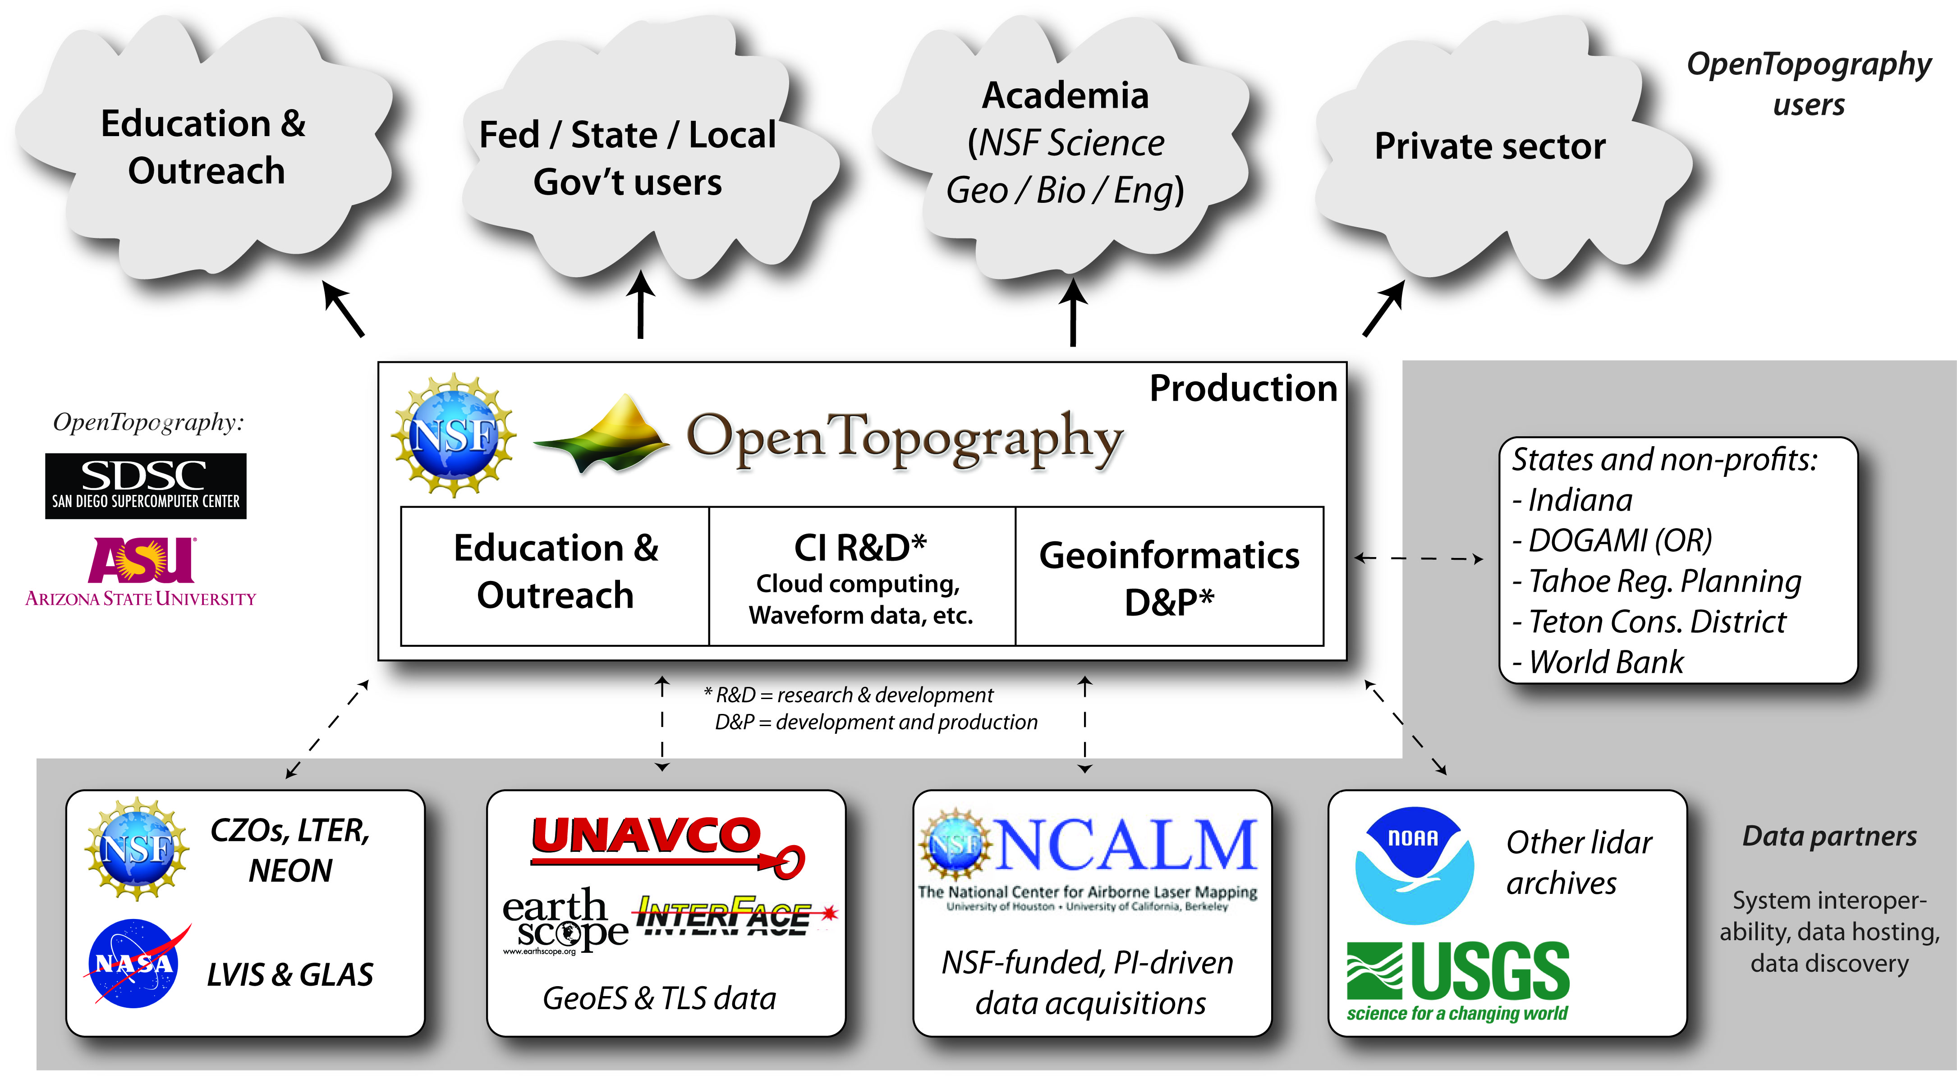

Slide 17
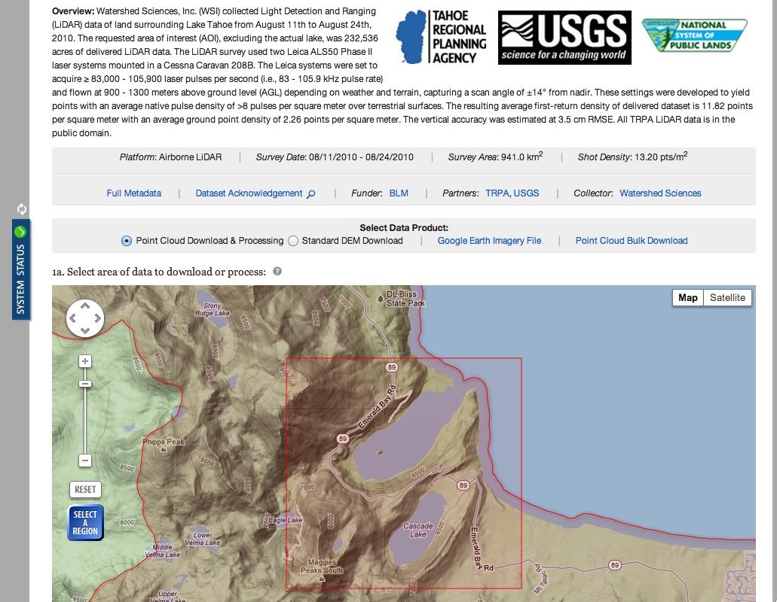
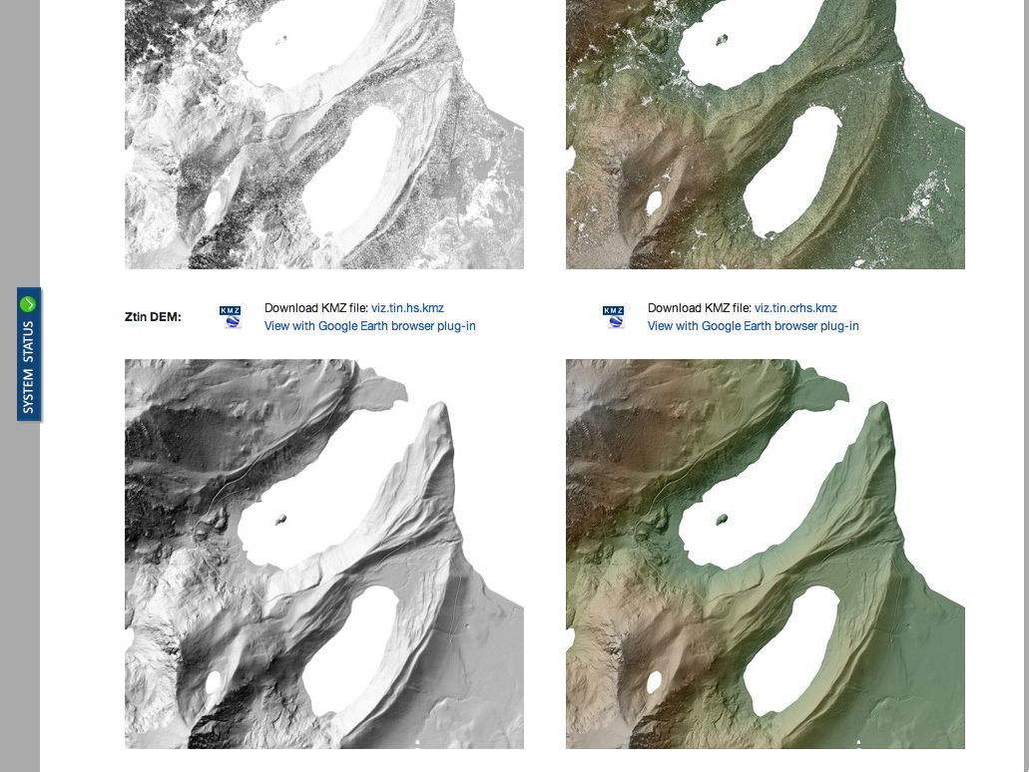
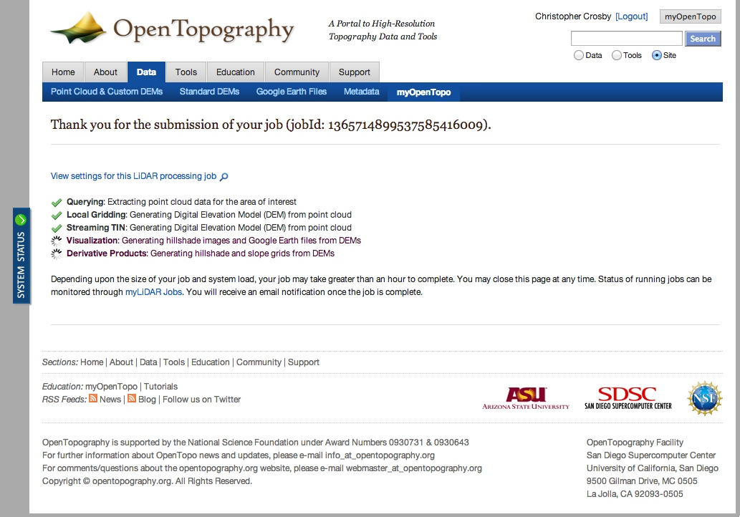

Slide 18
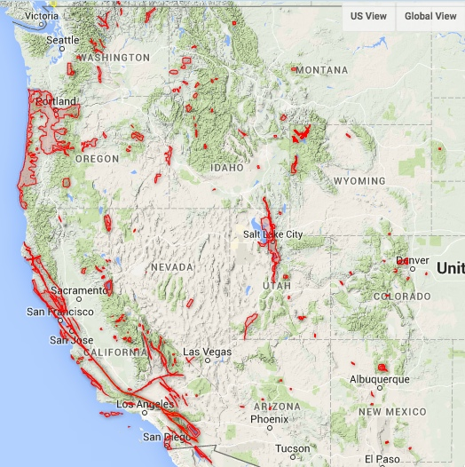
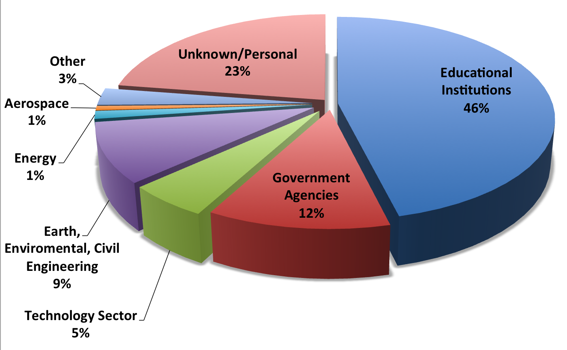
Status:
835 billion lidar returns
190 datasets
180, 000 km²
MOUs & Partnerships
NSF: NCALM, UNAVCO, CZOs, LTER
Other: World Bank, Tahoe Regional Planning Authority, Teton Conservation District, Oregon Lidar Consortium, Idaho Lidar Consortium, State of Indiana, PG&E.
10,000 registered users
54,000+ jobs
1.8 Trillion pts processed
Western US data available as of May 15, 2012

Slide 19
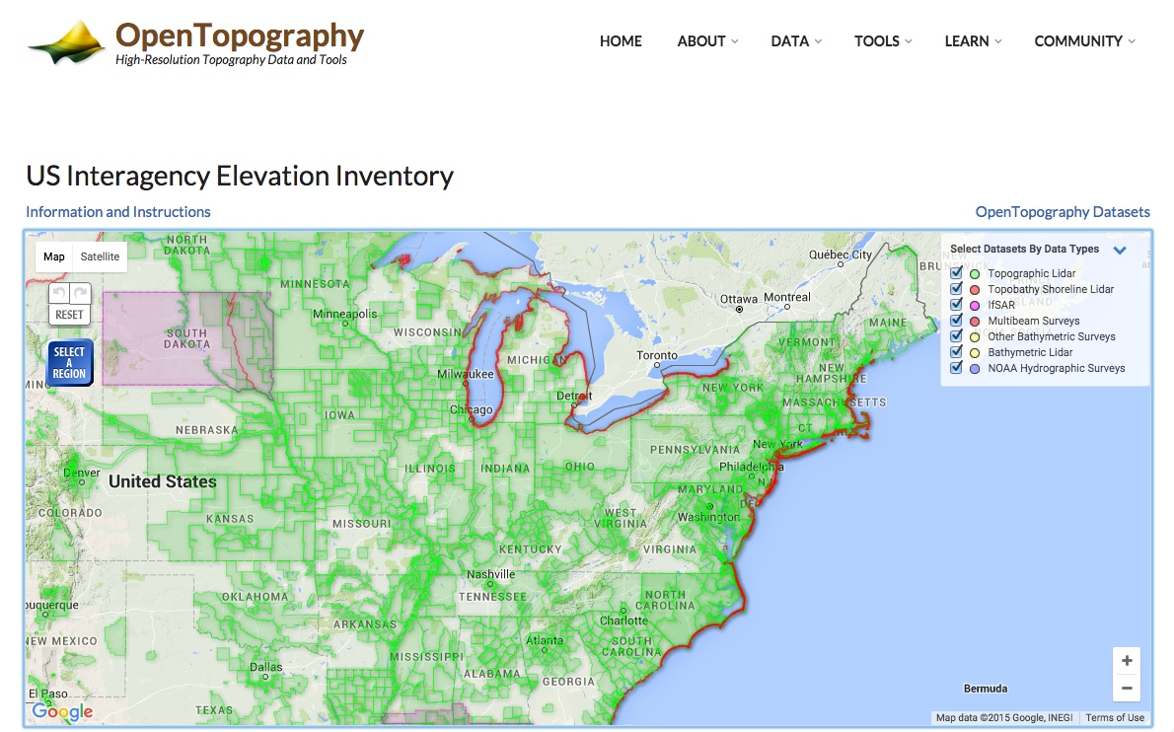

Slide 20
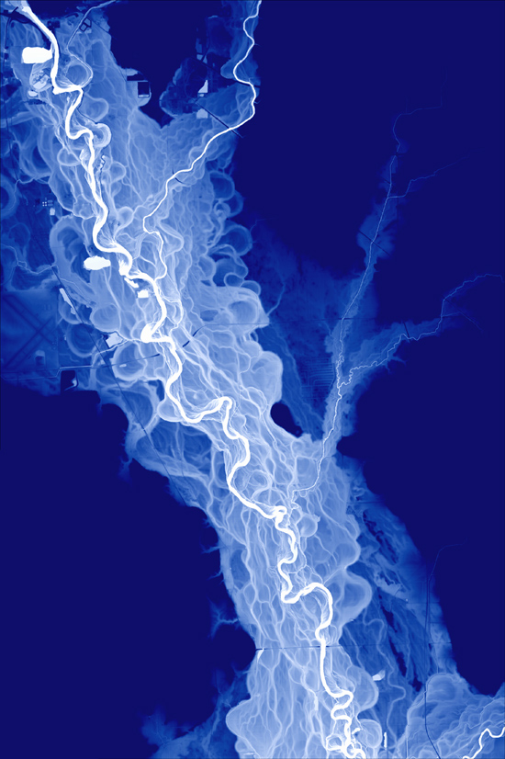





White River, IN
Credit: Indiana Geological Survey / State of Indiana
Thanks!
crosby@unavco.org
@OpenTopography
Facebook.com/OpenTopography
@OpenTopogaphy
info@opentopography.org
#211, NSF Street

